Slide 1

Hello
Does longer context help a small
character-level transformer?
Daniel Moody 23370157
Nandakishore Vinayakrishnan 23070854
Team: Eoin-Please-Give-Us-An-A1
LM173 BSc/MSc Immersive Software Engineering
Faculty of Science & Engineering
October 2026
1
Notes:
Suggested time: 0:00–0:30 (30 seconds). Introduce Daniel and Nandakishore. We trained a small transformer from scratch and asked whether seeing more previous characters improves next-character prediction.
Source document: https://docs.google.com/document/d/1wQspejjxxgstgN7gwZmUPBajmTMST3mfNqI_helQUlw/edit

Slide 2
Research question
Does seeing more previous characters
improve next-character prediction?
32 128 256 characters
Keep the number of training characters fixed.
Longer context costs more compute. Does it earn a better score?
2
Notes:
Suggested time: 0:30–1:30 (60 seconds). Explain that a character model predicts one character at a time. Context is the preceding text it can see. We compare 32, 128 and 256 characters while holding the training-character budget fixed. The question is whether any improvement exceeds variation across matched runs. More context increases attention work, but our measured training time rose only from about 1.92 to 2.12 minutes per run on a T4.
Source document: https://docs.google.com/document/d/1wQspejjxxgstgN7gwZmUPBajmTMST3mfNqI_helQUlw/edit

Slide 3
Model and controlled comparison
GPT-style decoder: 4 layers, 4 heads, width 192
About 1.8M parameters. AdamW. 3,000 steps.
Context length | Windows per batch | Characters per step
32 | 512 | 16,384
128 | 128 | 16,384
256 | 64 | 16,384
References: context 32 and a tuned character n-gram
3
Notes:
Suggested time: 1:30–2:45 (75 seconds). Our GPT-style decoder has 4 layers, 4 heads, width 192, dropout 0.1 and about 1.8 million parameters. AdamW uses a cosine learning-rate schedule from 0.001 to 0.0001. Every run trains for 3,000 steps. Each step contains 16,384 characters, so longer sequences mean fewer windows per batch. Within each fold we match the seed and shared initial weights. Learned positional embeddings differ in size. The tuned character n-gram provides a simple reference model.
Source document: https://docs.google.com/document/d/1wQspejjxxgstgN7gwZmUPBajmTMST3mfNqI_helQUlw/edit

Slide 4
Data and evaluation
TinyShakespeare: 1.1M characters, vocabulary of 65
81% train / 9% validation / 10% fixed test
10 validation folds, matched seeds, 30 transformer runs
Bits per character (BPC): lower is better
Score the same targets with a full context window.
Compare longer and shorter models within each fold.
4
Notes:
Suggested time: 2:45–4:00 (75 seconds). TinyShakespeare contains 1,115,394 characters and 65 distinct character types. We reserve the last 10% for test and divide the first 90% into 10 contiguous validation blocks, splitting at line breaks. Each run therefore uses about 81% train, 9% validation and the same 10% test. We train three contexts on each fold, for 30 transformer runs. Fold f uses seed f, so seed and fold effects are coupled. BPC is cross-entropy divided by ln 2. For final scoring, every model predicts the same target characters starting at character 257 and scores only the final position, with its full context available. This avoids the misleading comparison of average loss across all positions in different-length windows. We compare models within each fold. The folds share training text and the same test set, so t-intervals are approximate.
Source document: https://docs.google.com/document/d/1wQspejjxxgstgN7gwZmUPBajmTMST3mfNqI_helQUlw/edit

Slide 5
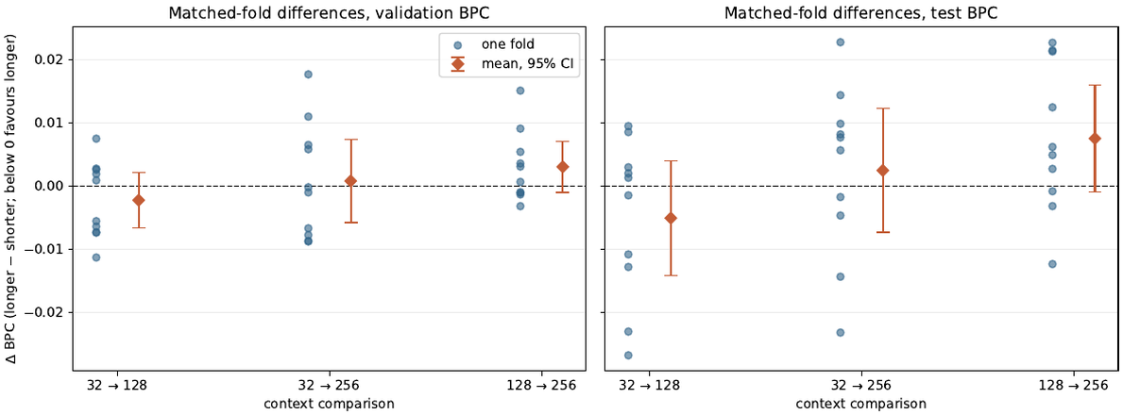
No convincing overall improvement
Mean test BPC: 32 = 2.1333 128 = 2.1283 256 = 2.1358
Tuned n-gram = 2.4954. All paired 95% intervals include zero.
5
Notes:
Suggested time: 4:00–5:30 (90 seconds). Show the mean test BPC for each condition. The transformer beats the tuned n-gram on every fold, by roughly 0.36 BPC on average. Context 128 has the lowest mean, but the advantage over 32 is only 0.0051 BPC. The paired test differences, longer minus shorter, are: 128 versus 32, minus 0.0051 with 95% CI minus 0.0142 to plus 0.0040; 256 versus 32, plus 0.0024 with CI minus 0.0074 to plus 0.0122; 256 versus 128, plus 0.0075 with CI minus 0.0009 to plus 0.0159. Every interval includes zero. These are approximate intervals from dependent folds, rather than proof of equivalence. The supplied headline means and paired differences differ slightly because of rounding.
Source document: https://docs.google.com/document/d/1wQspejjxxgstgN7gwZmUPBajmTMST3mfNqI_helQUlw/edit
Figure from the source document: matched-fold BPC differences on validation and test. Each dot is one fold. Orange diamonds and whiskers show means and 95% intervals. Every interval crosses zero.

Slide 6
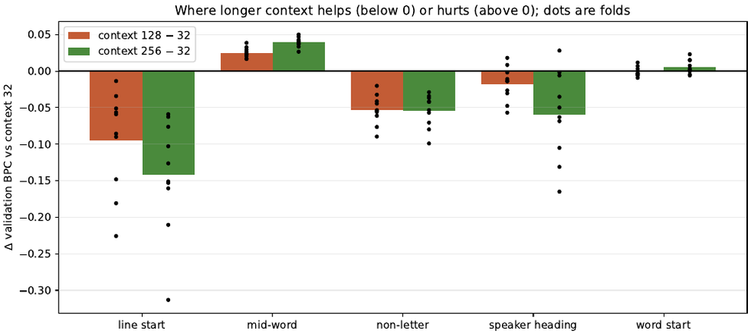
Longer context helps some patterns
Validation differences relative to context 32. Below zero is better.
Mid-word letters are 51.5% of targets, so their losses offset the gains.
6
Notes:
Suggested time: 5:30–6:45 (75 seconds). This table compares context 256 with context 32 on validation. Negative differences mean context 256 is better. It helps predict line starts, punctuation and speaker headings, but hurts letters inside words. Mid-word letters account for 51.5% of targets, so their penalty offsets the structural gains. These are observed category-level patterns. Our explanation is a hypothesis: at the same character budget, longer-context models see fewer sampled windows per step and may learn short-range patterns less effectively. We did not directly test that mechanism.
Source document: https://docs.google.com/document/d/1wQspejjxxgstgN7gwZmUPBajmTMST3mfNqI_helQUlw/edit
Figure from the source document: validation error categories, with context 128 and 256 compared against context 32. Negative bars show gains. Positive bars show losses. Mid-word letters account for 51.5% of targets.

Slide 7
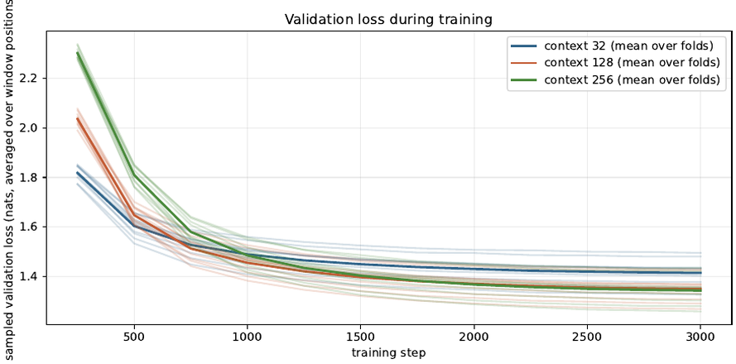
Conclusion and limitations
No convincing overall gain from longer context
at this model size and training budget.
27 of 30 runs chose the final checkpoint.
Fold 9 shows sensitivity to familiarity with the test play.
Next: a larger model and longer training.
Window-average loss can favour longer contexts.
7
Notes:
Suggested time: 6:45–7:50 (65 seconds). Within this model size and fixed training budget, longer context shows no convincing overall BPC improvement. It does change the types of errors. We should avoid generalising this to larger models, other datasets or longer training. Twenty-seven of thirty runs selected their checkpoint at the final step, so training may be incomplete. Fold 9 withheld the opening of the play continued in the test set. Its test performance was much worse for every condition, showing that absolute scores depend on familiarity with the play. Pairing helps control this shared shift, but does not establish that context effects generalise to new plays. The validation folds also overlap heavily in training data, limiting confidence-interval interpretation. A useful next experiment is a longer training budget, more independent seeds and a split holding out complete plays.
Source document: https://docs.google.com/document/d/1wQspejjxxgstgN7gwZmUPBajmTMST3mfNqI_helQUlw/edit
Figure from the source document: validation loss during training. This loss averages over all window positions. Longer windows contain proportionally fewer early positions with little context, so this plot cannot establish that a longer context predicts the common final targets better. The next experiment in the report is a second, larger model with more training steps.

Slide 8
Thank you
Questions?
Daniel Moody and Nandakishore Vinayakrishnan
8
Notes:
Suggested time: 7:50–8:00 (10 seconds). Thank the audience and invite questions.
Source document: https://docs.google.com/document/d/1wQspejjxxgstgN7gwZmUPBajmTMST3mfNqI_helQUlw/edit

